Slide 1



Semantic Search Journey @CareerBuilder
Khalifeh AlJadda
www.aljadda.com
Twitter: @aljadda
Search Data Science

Slide 2


About Me
Khalifeh AlJadda
Lead Data Scientist, Search Data Science
Joined CareerBuilder in 2013
PhD, Computer Science – University of Georgia
BSc, MSc, Computer Science, Jordan University of Science and Technology
Activities:
Founder and Chairman of CB Data Science Council
Frequent public speaker in data science and big data analytics domains
Creator of GELATO (Glycomic Elucidation and Annotation Tool)

Slide 3


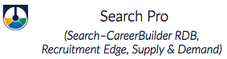








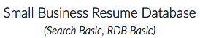















Search by the Numbers
100 million +
1,5 billion +
500+
30+
1
Searches per day
Documents indexed and searchable
Search Servers
Software Developers, Data Scientists + Analysts
Global Search Technology platform
Powering 50+ Search Experiences Including:
...and many more

Slide 4

Semantic Search
Semantic Knowledge Graph
Learning to Rank (LTR)
Query understanding
Keyword-based Search
Semantic Discovery
Khalifeh AlJadda
Mohammed Korayem
Roadmap

Slide 5

Learning to Rank (LTR)
Khalifeh AlJadda
Mohammed Korayem
Keyword-based Search

Slide 6
Keyword-based Search
Traditional search engines (i.e. Lucene, Solr, Elasticsearch) tokenize text and find documents containing those tokens and linguistic variations:
User’s Search: machine learning
Tokenization: ["machine", "learning"] =>
Stemming: ["machin", "learn"]
Final Query: machin AND learn
This could match a document for a “machinist” who has “learned” something.
software architect => … => software AND architect
Might identify a building architect requiring knowledge of specialized architecture software

Slide 7
Semantic Search (Search for Things not Strings)
We need a way to identify and search for the meaning of keyword phrases, not just the individual text tokens
i.e. machine learning = "machine learning" OR "data scientist" OR "mahout" OR "svm" OR "neural networks”

Slide 8
Our Target
User’s Query: machine learning research and development Portland, OR software engineer AND hadoop, java
Traditional Query Parsing: (machine AND learning AND research AND development AND portland) OR (software AND engineer AND hadoop AND java)
Semantic Query Parsing: "machine learning" AND "research and development" AND "Portland, OR" AND "software engineer" AND hadoop AND java

Slide 9

Our Target
Semantically Expanded Query: ("machine learning"^{^10} OR "data scientist" OR "data mining" OR "artificial intelligence") AND ("research and development"^{^10} OR "r&d") AND AND ("Portland, OR"^{^10} OR "Portland, Oregon" OR {!geofilt pt=45.512,-122.676 d=50 sfield=geo}) AND ("software engineer"^{^10} OR "software developer") AND (hadoop^{^10} OR "big data" OR hbase OR hive) AND (java^{^10} OR j2ee)
+
Job Level
Job title
Company

Slide 10

Learning to Rank (LTR)
Khalifeh AlJadda
Mohammed Korayem
Semantic Discovery

Slide 11
Possible Solutions
Natural Language Processing (NLP)
Not a good option for CB (different languages)
Manual Taxonomies/Ontologies:
Not Scalable
Expensive, Manpower is required for every supported language
Difficult to maintain
Statistical ML
Language-agnostic
Fast and scalable

Slide 12
Job Seeker
Search Behavior
Recruiter
Search Behavior
Content-based Filtering

Slide 13
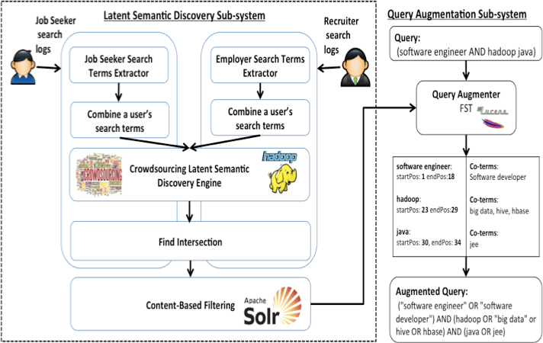
Possible Solutions
*Crowdsourced Query Augmentation through Semantic Discovery of Domain-specific Jargon

Slide 14

Source of Semantic Knowledge
java developer
Search logs are untapped source of semantic knowledge.
A user usually search for related terms.
Considering searches conducted by users with the same classification, reveal semantic relations between terms.
java
J2EE
Registered Nurse
RN
lpn

Slide 15
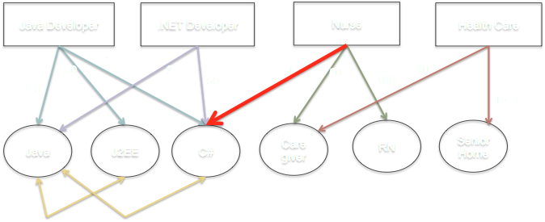
PGMHD
*PGMHD: A Scalable Probabilistic Graphical Model for Massive Hierarchical Data Problems
**Mining Massive Hierarchical Data Using a Scalable Probabilistic Graphical Model

Slide 16
P(Java,J2EE| Java Developer) = P(Java|Java Developer) * P(J2EE|Java Developer)
= 5/7 * 10/10
P(Java,C#|Java Dev, .NET Dev) = P(Java|Java Dev)*P(Java|.NET Dev)
* P(C#|Java Dev) * P(C#|.NET Dev)
= 5/7 * 2/7 * 3/53 * 50/53

Slide 17
Input Hive Table
Sample Input Row
Term_Frequency | Classification
Java_20,Java Dev_10,J2EE_7 | Java Developer
Map
Reduce
Split the list of terms.
Use each term as the key.
Concatenate the other terms and use this concatenated string as the value
Classify the term.
Find co-occurring terms.
Calculate each term’s popularity.
Key: term
Val: co-terms
Output Hive Table
Term | Co-term_Frequency | Popularity | Classification
Java | Java Dev_18,J2EE_15,JSP_10 | 20 | Java Developer
Sample Output Row

Slide 18
Recruiter’s Query
(“sales” or "sales rep" or "sales representative" or "cold call" or "cold calling" or "customer service" or "call center" or "outbound sales" or “outside sales” or “inside sales”) or ("account manager" or "account executive" or "executive admin" or "executive assistant" or "territory manager")

Slide 19
Possible Solutions
*Crowdsourced Query Augmentation through Semantic Discovery of Domain-specific Jargon

Slide 20



Recruiter’s Query
(“sales” or "sales rep" or "sales representative" or "cold call" or "cold calling" or "customer service" or "call center" or "outbound sales" or “outside sales” or “inside sales”) or ("account manager" or "account executive" or "executive admin" or "executive assistant" or "territory manager")

Slide 21

Discovering ambiguous phrases
Classify users who ran each search in the search logs (i.e. by the job title classifications of the jobs to which they applied)
Create a probabilistic graphical model of those classifications mapped to each keyword phrase.
Segment the search term => related search terms list by classification, to return a separate related terms list per classification
*Query Sense Disambiguation Leveraging Large Scale User Behavioral Data

Slide 22
Disambiguated meanings (represented as term vectors)
Example | Related Keywords (Disambiguated Meanings)
architect | 1: enterprise architect, java architect, data architect, oracle, java, .net
 | 2: architectural designer, architectural drafter, autocad, autocad drafter, designer, drafter, cad, engineer
driver | 1: linux, windows, embedded
 | 2: truck driver, cdl driver, delivery driver, class b driver, cdl, courier
designer | 1: design, print, animation, artist, illustrator, creative, graphic artist, graphic, photoshop, video
 | 2: graphic, web designer, design, web design, graphic design, graphic designer
 | 3: design, drafter, cad designer, draftsman, autocad, mechanical designer, proe, structural designer, revit
… | …

Slide 23
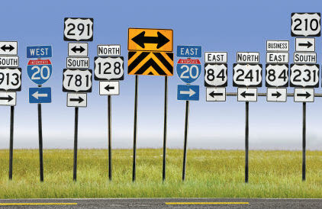
Learning to Rank (LTR)
Khalifeh AlJadda
Mohammed Korayem
SKG (Cleanup Noise)

Slide 24
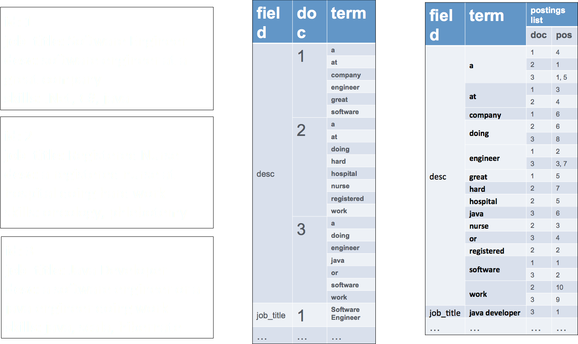

Slide 25
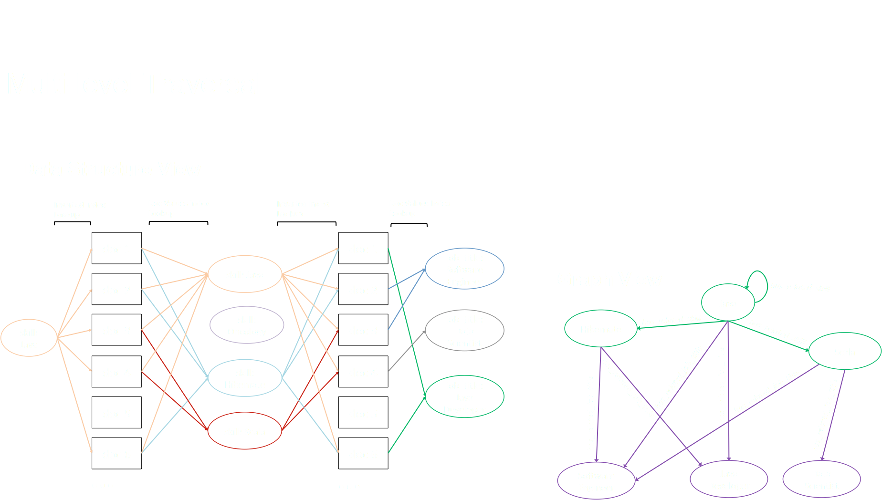

Slide 26

Trey Grainger, Khalifeh AlJadda, Mohammed Korayem, Andries Smith.“The Semantic Knowledge Graph: A compact, auto-generated model for real-time traversal and ranking of any relationship within a domain”. DSAA 2016

Slide 27
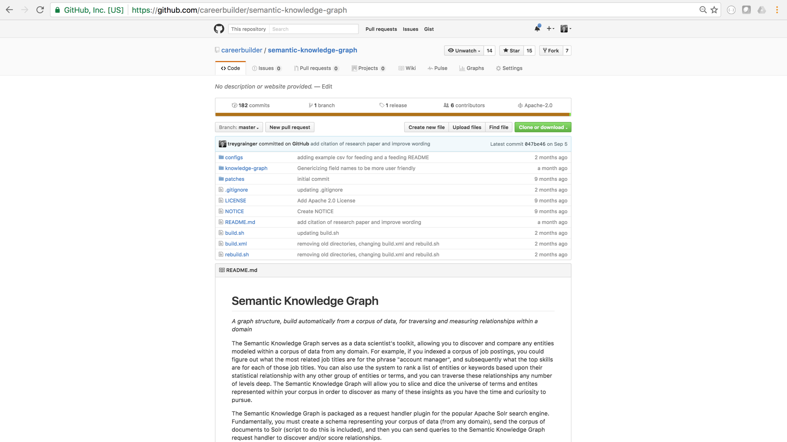


Slide 28
Possible Solutions
*Crowdsourced Query Augmentation through Semantic Discovery of Domain-specific Jargon

Slide 29

Learning to Rank (LTR)
Khalifeh AlJadda
Mohammed Korayem
Query Understanding

Slide 30
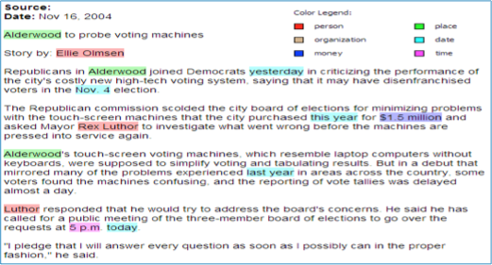
Named Entity Recognition
Identifying regions of text corresponding to entities
Categorizing recognized entities into predefined classes

Slide 31
Challenges
Search queries are short, context-less
google, driver, intern, .net 0.4, uncc...
Some entities have multiple surface forms
university of north carolina charlotte, unc charlotte, uncc
Domain specific entities
registered nurse (rn), licensed practical nurse (lpn), director of nurse (don)

Slide 32
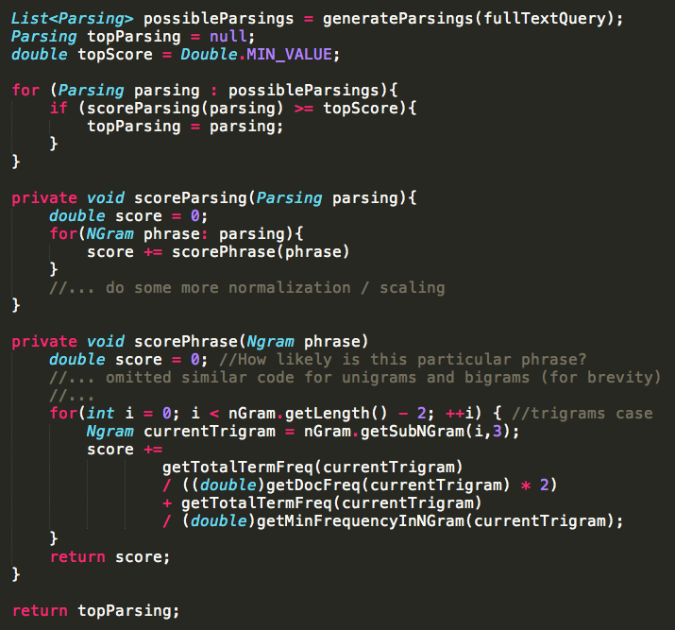
Probabilistic Query Parser
Goal: given a query, predict which combinations of keywords should be combined together as phrases
Example: senior java developer hadoop
Possible Parsings:
senior, java, developer, hadoop
"senior java", developer, hadoop
"senior java developer", hadoop
"senior java developer hadoop”
"senior java", "developer hadoop”
senior, "java developer", hadoop
senior, java, "developer hadoop"

Slide 33
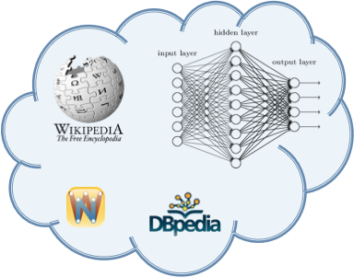
Entity-type Recognition
Build classifiers trained on
External data sources
(Wikipedia, DBPedia, WordNet, etc.), as well as from our own domain.
registered nurse
skill
director
java developer
location
Portland, OR
work type
emergency room
job title
part-time
job level
*Entity Type Recognition using an Ensemble of Distributional Semantic Models to Enhance
Query Understanding

Slide 34
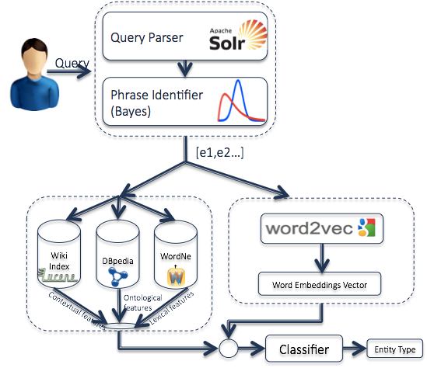

Slide 35

Semantic Search

Slide 36


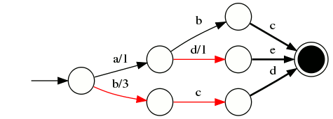



Query Augmentation
Keywords:
Known keyword phrases
+
machine learning
java developer
machine learning registered nurse
Related Phrases
FST
Semantic Query Augmentation
Search Behavior,
Application Behavior, etc.
machine learning:
{ data mining .9, matlab .8, data scientist .75, artificial intelligence .7, neural networks .55 }
Common Job Titles
Modified Query:
machine learning:
{ software engineer .65, data manager .3, data scientist .25, hadoop engineer .2, }
keywords:((machine learning)^10 OR { AT_LEAST_2: ("data mining"^0.9, matlab^0.8, "data scientist"^0.75, "artificial intelligence"^0.7, "neural networks"^0.55)) }
{ BOOST_TO_TOP: ( job_title:( "software engineer" OR "data manager" OR "data scientist" OR "hadoop engineer")) }
Related Occupations
machine learning: {15-1031.00 .58 Computer Software Engineers, Applications
15-1011.00 .55
Computer and Information Scientists, Research
15-1032.00 .52 Computer Software Engineers, Systems Software }
Knowledge Graph in
Job Title Classifier, Skills Extractor, Job Level Classifier, etc.

Slide 37
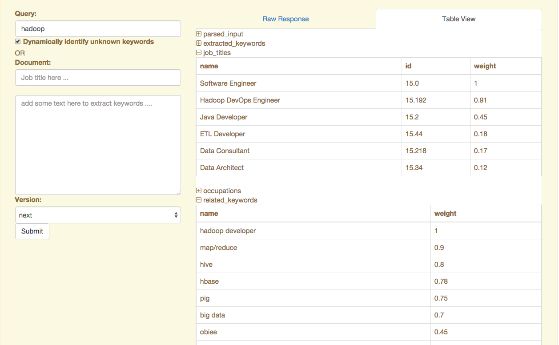
Query Enrichment
Query Augmentation

Slide 38
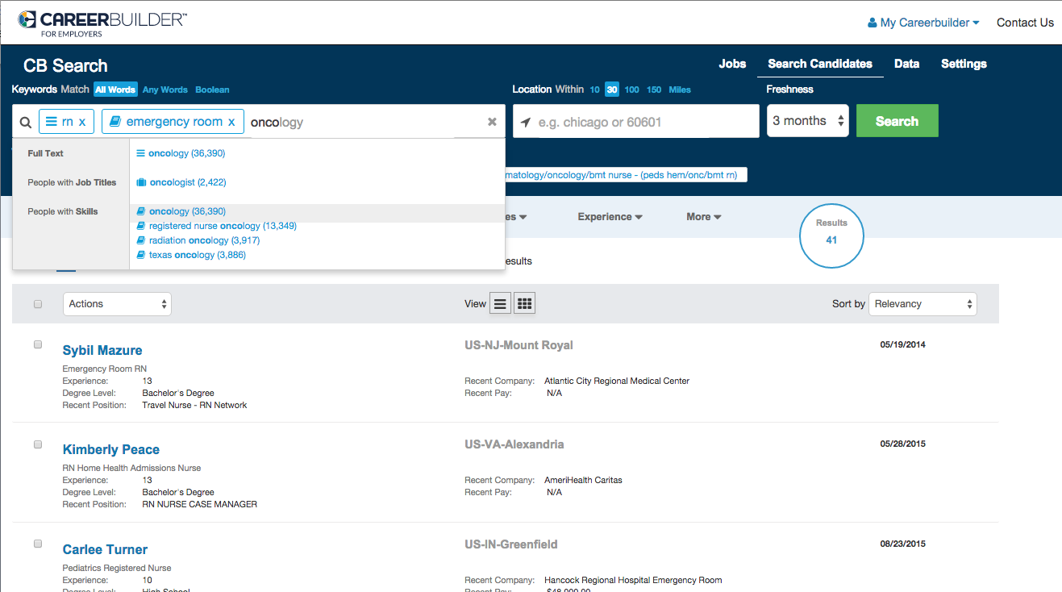


Semantic Autocomplete
Shows top terms for any search
Breaks out job titles, skills, companies, related keywords, and other categories
Understands abbreviations, alternate forms, misspellings
Supports full Boolean syntax and multi-term autocomplete
Enables fielded search on entities, not just keywords

Slide 39


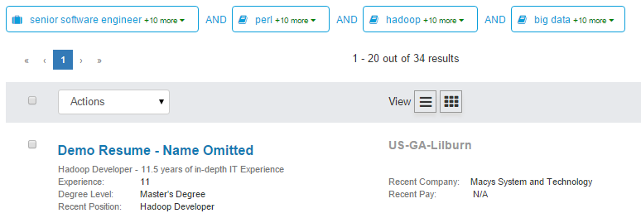
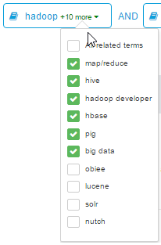

Slide 40
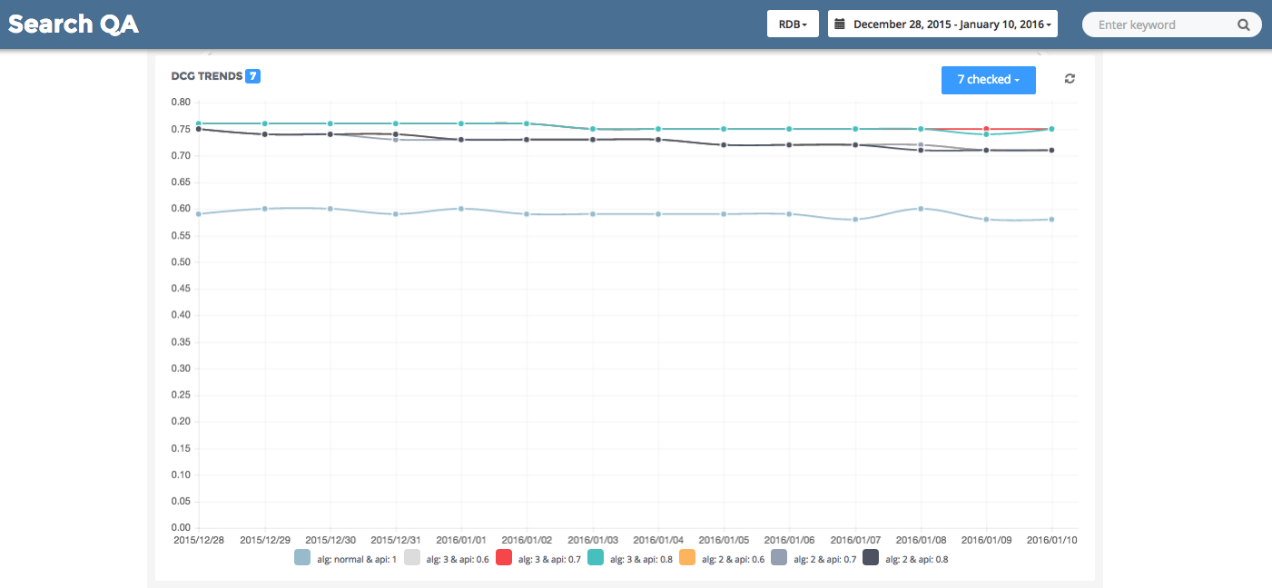
Search QA System:
Traditional Keyword Search
Semantic Search Algorithms

Slide 41
Overall View
Search Box
Intent Engine
Entity / Entity Type Resolution
Contextual Disambiguation
Type-ahead Prediction
Query Augmentation
Semantic Query Parsing
User Feedback (Clarifying Intent)
Spelling Correction
Knowledge Graph
Relevancy Engine (“re-expressing intent”)
Query Re-writing
Machine-learned Ranking
Search Results

Slide 42
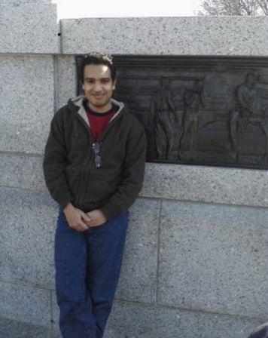

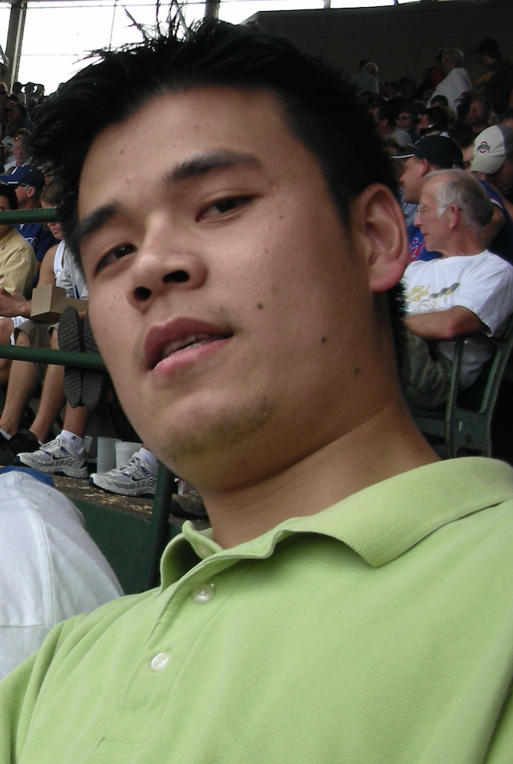

Mohammed Korayem
Trey Gringer
Hai Liu
Walid Shalaby
Credit

Slide 43

We Are Hiring! (Full Time/Intern)

Slide 44

Thank You!
www.aljadda.com @aljadda

